Slide 1
Software Engineering
Intermediate Report

Slide 2
1. About our Application
2. Scrum
3. SRS
4. Analysis Model
I n d e x

Slide 3
About our application
1

Slide 4
HYUⓔmini
Objective
“Simplicity is the ultimate sophistication.”
Leonardo da Vinci
Notes:
HYUⓔmini Project는 기존의 한양대학교 애플리케이션에서 학생들에게 자주 이용되는 필수적인 기능만을 추출하여 좀 더 사용하기 편하게 리팩토링하여 서비스를 제공하기 위해 시작되었습니다.

Slide 5
HYUⓔmini
Target User
Original
HYUⓔmini
Seoul Campus Professor Academy
Employee
… Too Complex!
ERICA Student ONLY!
Notes:
기존의 한양대 앱은 서울캠 학생들, 교수님들, 대학원생분들, 직원분들이 모두 사용자였기 때문에, 앱이 담고있는 기능들 또한 매우 복잡했습니다.
저희 앱은 오로지 에리카 학생들을 대상으로 하며, 앱에는 에리카 학생에게 꼭 필요한 기능만을 엄선하여 담기로 기획했습니다.

Slide 6


HYUⓔmini
Target Platform

Slide 7
HYUⓔmini
Stakeholder
Prof. Scott Lee
Manager (School)
Ten Developers
ERICA Students

Slide 8
Scrum
2

Slide 9
Why?
Why are we select Scrum?
Speed up development
Can introduce XP partially.
Notes:
이터레이션 중에 요구사항 변경이 없음.
효율적인 분업
빠른 개발
주기적인 요구사항 리뉴얼

Slide 10
How?
How can we apply Scrum to our project?
Free Member Switching
Apply XP Methodology
Daily Scrum Meeting

Slide 11
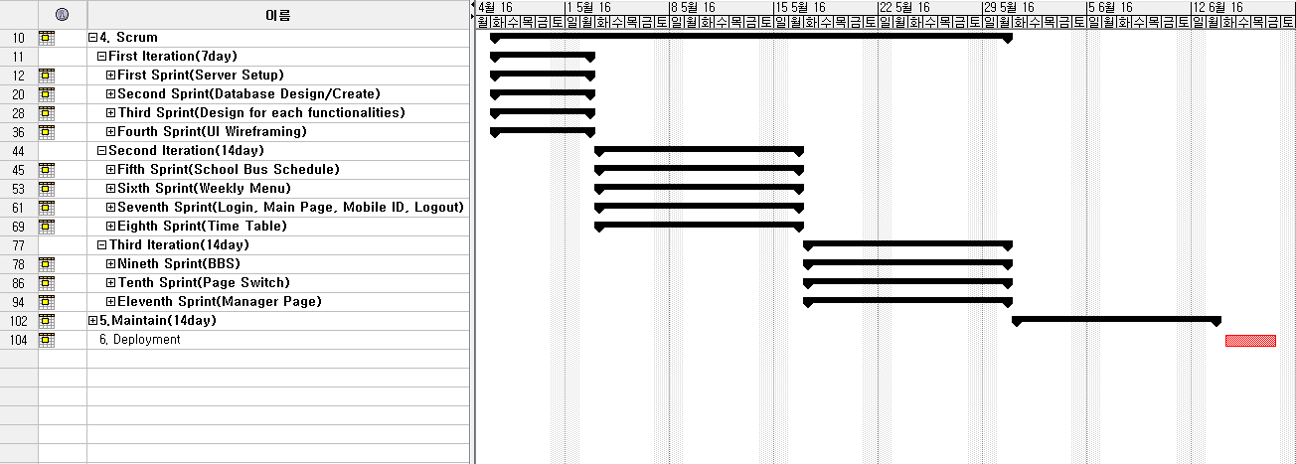
Scrum planning
Gantt Chart

Slide 12
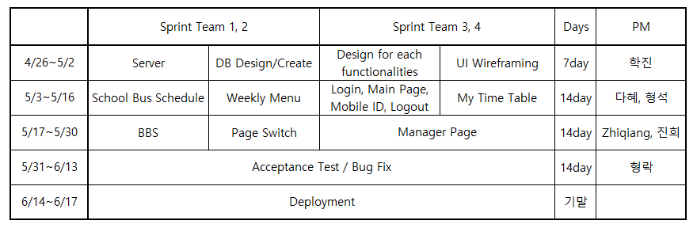
Scrum planning
Scrum Chart

Slide 13
SRS
3

Slide 14
SRS Format
1. Introduction
Purpose
Scope of Project
Glossary
Overview of Document

Slide 15
SRS Format
2. Overall Description
System Environment
User Characteristics
Use Cases
Use Case 1: Login System
Description
Use Case Diagram
Use Case 2: Main Page
…

Slide 16
SRS Format
3. Requirements Specification
Use Case1: Login System
Functional Requirement1: …
Functional Requirement2: …
…
Non-functional Requirement5: …
…
Use Case2: Main Page
Functional Requirement1: …
…
…
Non Functional Requirements
non-functional requirements 1
non-functional requirements 2
…

Slide 17
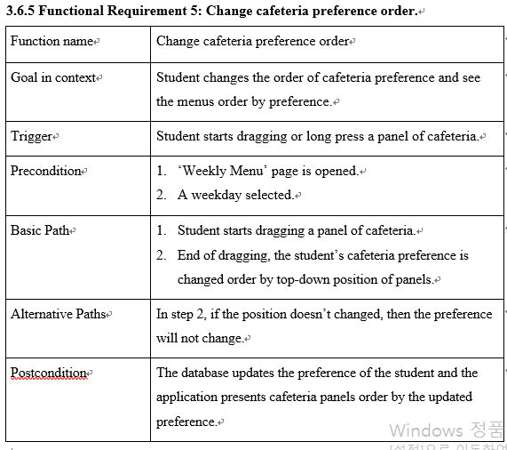
SRS Format(Example)
Functional requirement chart example
Notes:
Fully Dressed Format과 Casual Format의 중간점

Slide 18
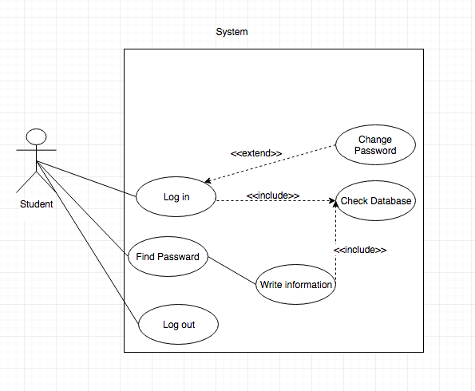
Use Case 1. Login/Logout
Use Case 1. Login/Logout

Slide 19
Use Case 1. Login/Logout
Description(User Scenario)
Want to check information
-> 1. Find Password 2. Input ID, Password
-> Change password
-> Log out

Slide 20
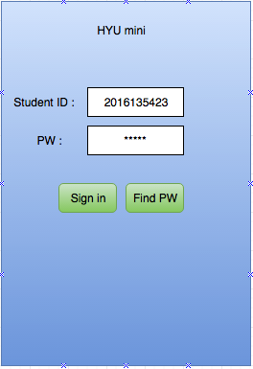
Use Case 1. Login/Logout
Functional Requirement
Log-in
Precondition | User types ID and PW in each edit box and Sign in.
Basic Path | User input his ID and password in edit box. User click the ‘Sign in’ button.
Alternative Path | In step 1, if student clicks the ‘Remember’ checkbox, the application should record the user ID and password in cookies. In step 1, if student forgot the password, User click the ‘Find Password’ Button.
Postcondition | Show the Mainpage to user
remember

Slide 21
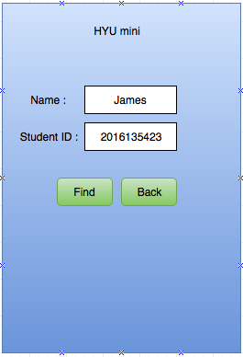
Use Case 1. Login/Logout
Functional Requirement
Find password
Precondition | User is in login page.
Basic Path | Input the User’s name Input the User’s Student ID Click the Find button
Alternative Path | In step 3, if user clicks the ‘Back button’, Go to Login Page.
Postcondition | Show the user’s password

Slide 22
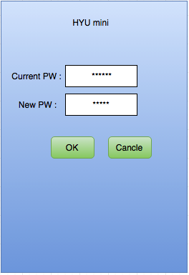
Use Case 1. Login/Logout
Functional Requirement
Change password
Precondition | User already log in.
Basic Path | User is in mainpage User click the ‘Change PW’. User go to Change PW page.
Alternative Path | In step 3, if user clicks the ‘Cancle button’, show the Mainpage.
Postcondition | Show Congratulation message. After 2 second, Show the Mainpage.

Slide 23
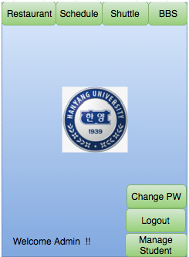
Use Case 1. Login/Logout
Functional Requirement
Logout
Precondition | User already log in this system User is in Mainpage
Basic Path | User Log in the system User click ‘Logout button’.
Alternative Path
Postcondition | Clean up the user information
Jaems

Slide 24
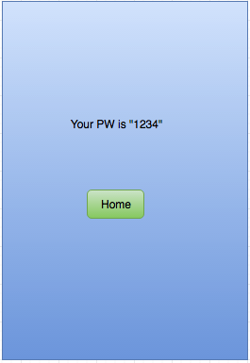
Use Case 1. Login/Logout
Non-Functional Requirement
Easy to know, Simple

Slide 25
Use Case 2. Main Page
Use Case Diagram

Slide 26
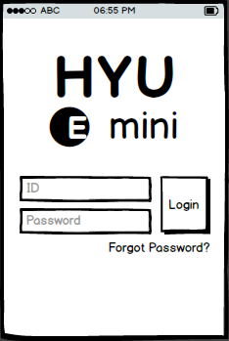
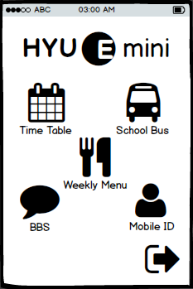
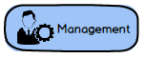
Use Case 2. Main Page
Description(User Scenario)
Login
Succeed
Manager Login
Login Page
Main Page

Slide 27



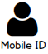
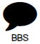

Use Case 2. Main Page
Requirements
Logout
Notes:
Func-Req1. See Main Menus
Func-Req2. Select Main Menu
Manager는 따로 보여줌

Slide 28
Use Case 3. BBS

Slide 29

Use Case 3. BBS
Student or Master logins the application

Slide 30
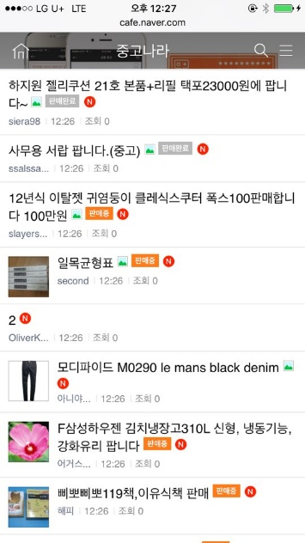

Use Case 3. BBS
1/3. In the List Page (BBS main page)
Pre-con. Student accesses into a bulletin board page

Slide 31



Use Case 3. BBS
1/3. In the List Page (BBS main page)
The list page added content written
Write
Writing Contents
Pre-con. Student accesses into a bulletin board page
The list page of the searching result
input
Searching Contents
The content page
Title
Reading Contents

Slide 32
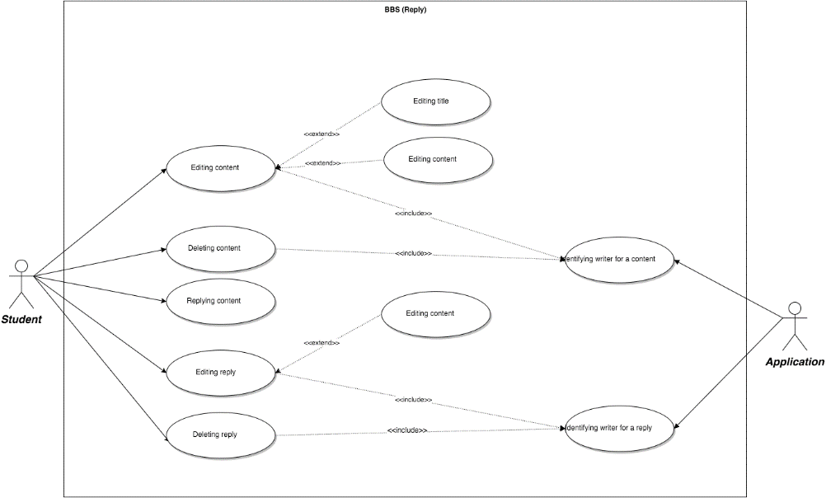
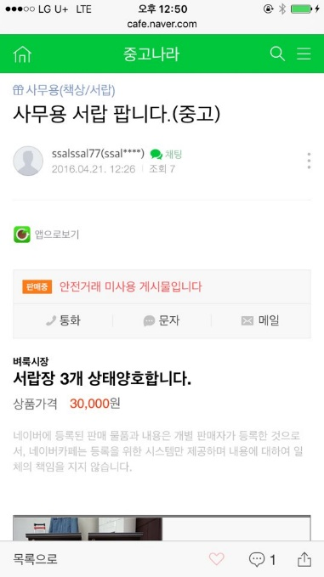


Use Case 3. BBS
2/3. In the Content Page
Pre-con. Student accesses into the content page
Pre-con. Student wrote the content before

Slide 33




Use Case 3. BBS
2/3. In the Content Page
The content page updating edited content or reply
Pre-con. Student accesses into the content page
Editing
Deleting Contents
Edit
The content page updating deleted content or reply
Delete
Pre-con. Student wrote the content before
The content page
Reading Writing
Editing Deleting Reply
Title
Write
The content page added reply
Edit
Delete

Slide 34

Use Case 3. BBS
3/3. As a Master (in the content page)
Deleting Contents
Delete
Pre-con. Master don’t need to pre-con. in constraint to student
The content page updating deleted content or reply
Deleting Reply
Delete

Slide 35
Use Case 4. Bus Schedule

Slide 36
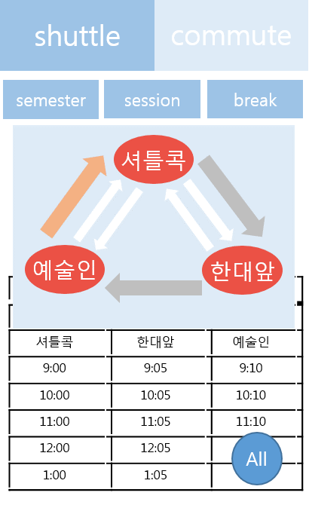
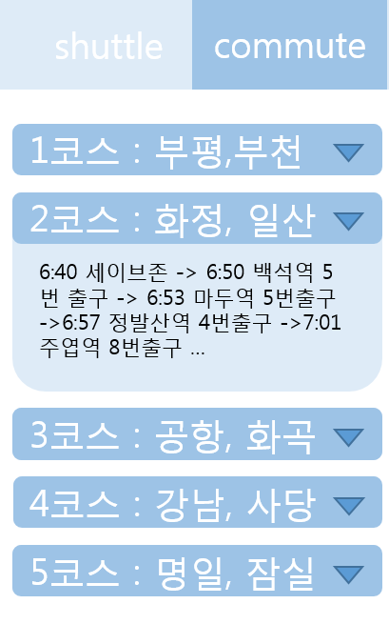

Slide 37
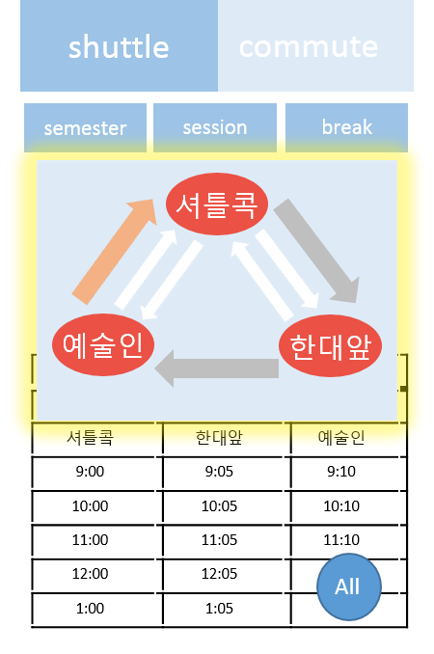
Use Case 4. Bus Schedule
Show current shuttle bus schedule
Precondition | Log in to ‘HYUⓔmini’ application
Trigger | User clicks ‘Bus Schedule’ button
Basic Path | 1. User can see two tabs(Shuttle bus and Commute bus). And default is shuttle bus tab. 2. ’Shuttle Bus Schedule’ shows shuttle bus schedule in graphical format.(Bus on operating is showed with tracking the current location of the bus)
Alternative Paths | In step 1, It ‘Commute bus schedule’ tab is clicked, User can see the commute bus schedule. In step 2, If ‘Entire shuttle schedule’ is clicked, User can see whole shuttle bus schedule.
Postcondition | Shuttle bus schedule is provided in visualized format

Slide 38
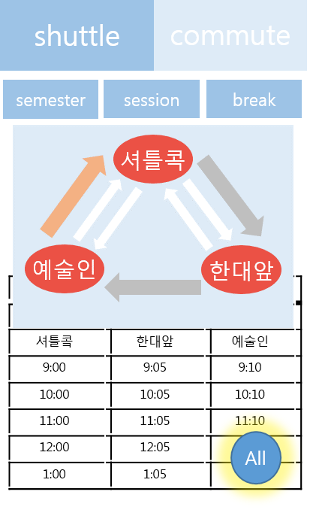
Use Case 4. Bus Schedule
Show entire shuttle bus schedule
Precondition | User checked shuttle bus schedule
Trigger | User clicks ‘Entire shuttle schedule’ button
Basic Path | User clicks ‘Entire shuttle schedule’ button to check entire shuttle bus schedule. User can see all shuttle bus schedule from the start time
Alternative Paths
Post Condition | Entire ‘Semester’ shuttle bus schedule is provided in visualized format

Slide 39
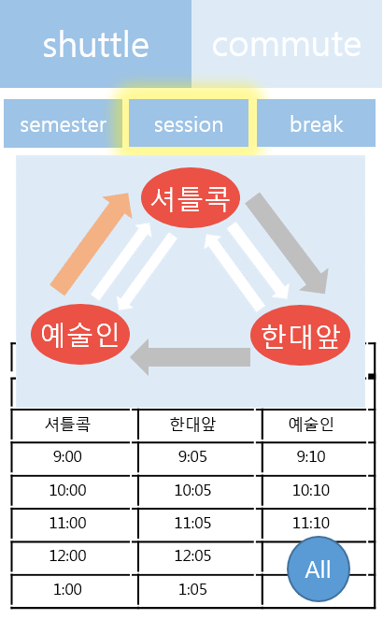
Use Case 4. Bus Schedule
Show entire shuttle bus schedule for session
Precondition | User checked semester or break shuttle bus schedule
Trigger | User clicks the ‘session’ tab
Basic Path | User can see shuttle bus schedule of session term ’Shuttle Bus Schedule’ shows shuttle bus schedule in graphical format.
Alternative Paths | In step 2, If ‘Entire shuttle schedule’ is clicked, User can see whole shuttle bus schedule.
Post Condition | Entire ‘Session’ shuttle bus schedule is provided in visualized format

Slide 40
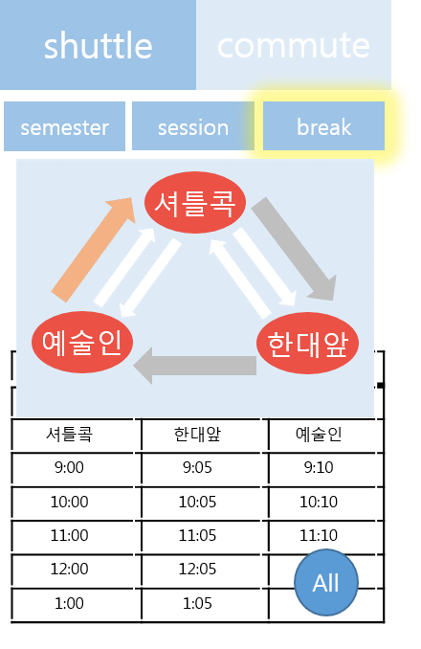
Use Case 4. Bus Schedule
Show entire shuttle bus schedule for break
Precondition | User checked semester or session shuttle bus schedule
Trigger | User clicks the ‘break’ tab
Basic Path | User can see shuttle bus schedule of break term ’Shuttle Bus Schedule’ shows shuttle bus schedule in graphical format.
Alternative Paths | In step 2, If ‘Entire shuttle schedule’ is clicked, User can see whole shuttle bus schedule.
Post Condition | Entire ‘Break’ shuttle bus schedule is provided in visualized format

Slide 41
Use Case 4. Bus Schedule
Show commute bus schedule
Precondition | User checked shuttle bus schedule
Trigger | User clicks commute bus schedule tab
Basic Path | 1. User clicks commute bus schedule tab to check commute bus schedule. 2. In commute bus schedule tab, user can select which route to be displayed among 9 routes. 3. Application displays selected route.
Alternative Paths
Postcondition | Commute bus schedule is provided in visualized format

Slide 42
Use Case 5. Time Table
Description for Time Table
Lecture Schedule is for student who want to see lecture schedule in 'HYUⓔmini'. In addition to basic function of showing lecture schedules, 'HYUⓔmini' also provides highlight view mode of making highlight to current schedule, adding personal schedule function that user can add their personal schedule and sharing function that user can share their schedule through ‘Kakao Talk’. Also user can save their schedule in their local machine

Slide 43
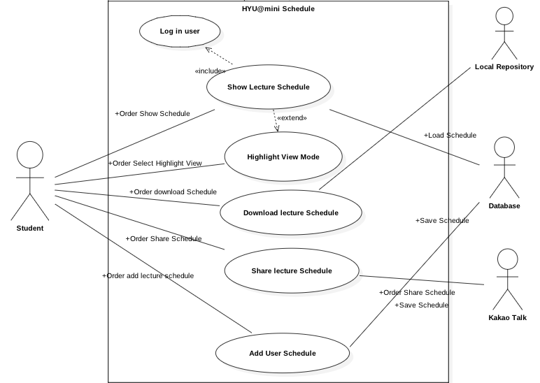
Use Case 5. Time Table
Use Case Diagram

Slide 44
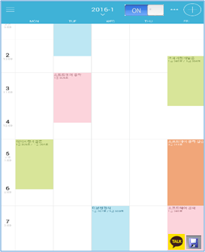

Use Case 5. Time Table
Show Lecture Schedule

Slide 45
Use Case 5. Time Table
Download Schedule

Slide 46
Use Case 5. Time Table
Share Schedule

Slide 47
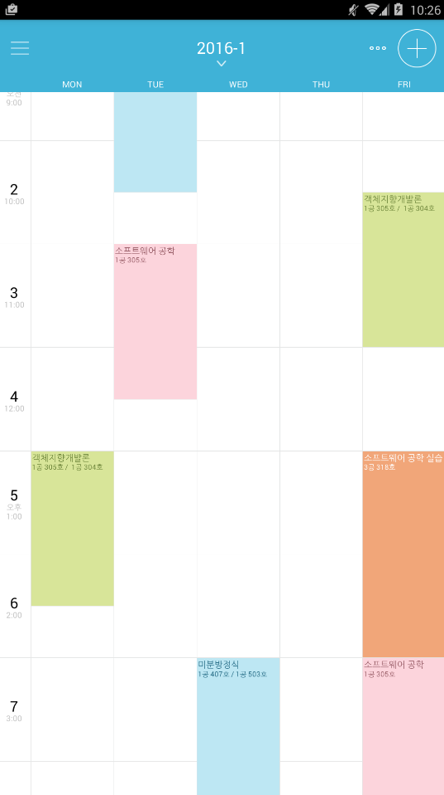

Use Case 5. Time Table
Highlight View
다음 일정 입니다
10:30 AM

Slide 48
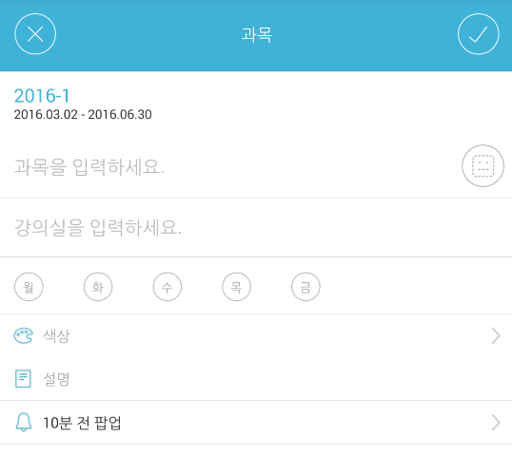

Use Case 5. Time Table
Add User Schedule
일 정
일정을 입력하세요
시간을 입력하세요

Slide 49


Use Case 5. Time Table
Non-Functional
If “Kakoa Talk” didn’t installed in local machine and mobile phone, user can’t access the Share lecture Schedule function in “HYUⓔmini”
The system should protect itself and its sensitive data from unauthorized access, malicious, modification. If there is no reaction, the user will be log-out automatically

Slide 50
Use Case 6. Weekly Menu
Use Case Diagram

Slide 51
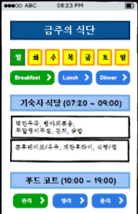
Use Case 6. Weekly Menu
Description(User Scenario)
Button
Pressed

Slide 52
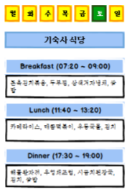
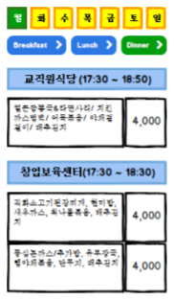
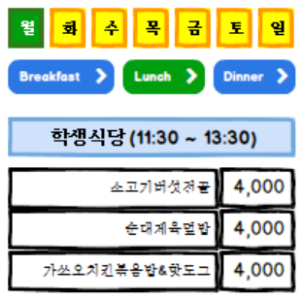
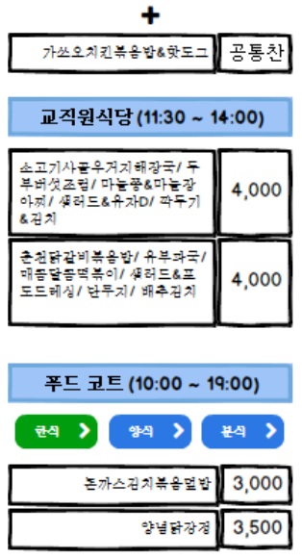
Use Case 6. Weekly Menu
Requirements
Notes:
요일선택
시간대선택 아침 점심 저녁
한번에 다 보이는 UI
푸드코트 한식 분식 양식

Slide 53
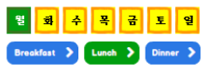
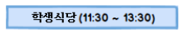
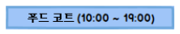
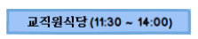
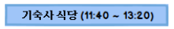
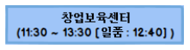
Use Case 6. Weekly Menu
Requirements
Dragging

Slide 54
Use Case 7. Manager Page
Our own database
Maliciious modifying

Slide 55
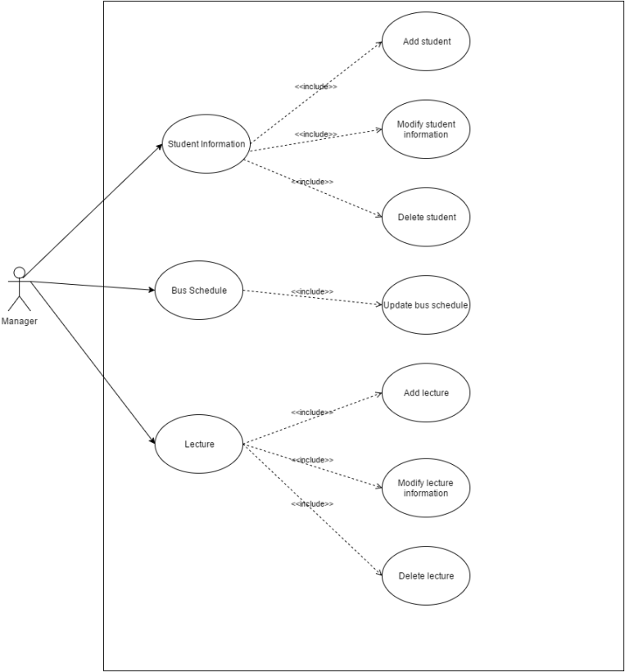
Use Case 7. Manager Page
Use Case Diagram

Slide 56
Use Case 7. Manager Page
Functional Requirement
- Student information
- Bus schedule
- Lecture
Manage
back
Student
Bus Schedule
Lecture

Slide 57
Use Case 7. Manager Page
Student information
- Add new student
- Modify student information
- Delete student
Manage Student
back
Add
Student 1
Student 1
Student 1
Student 1
Student 1

Slide 58
Use Case 7. Manager Page
Bus schedule
- Update(modify) bus schedule
Manage Bus Schedule
back
Update Shuttle Bus Schedule
Update Commute Bus Schedule

Slide 59
Use Case 7. Manager Page
Bus schedule
- Update(modify) bus schedule
Manage Bus Schedule
back
semester
session
break
셔틀콕 | 한대앞 | 예술인
9:00 | 9:05 | 9:10
10:00 | 10:05 | 10:10
11:00 | 11:05 | 11:10
12:00 | 12:05 | 12:10
13:00 | 13:05 | 13:10
Save

Slide 60
Use Case 7. Manager Page
Lecture
- Add lecture
- Modify lecture information
- Delete lecture
Manage Lecture
back
Add
Lecture 1
Lecture 1
Lecture 1
Lecture 1
Lecture 1

Slide 61
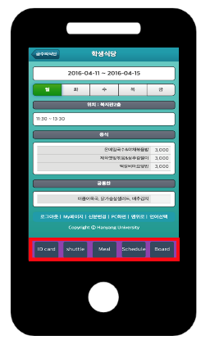

Use Case 8. Page Switch

Slide 62
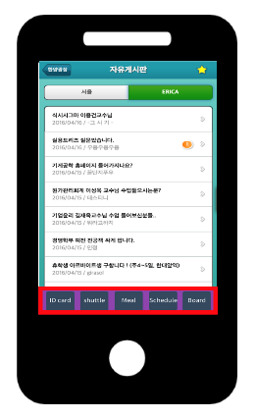
Use Case 8. Page Switch
Intuitive One Click
Access All Category Successfully

Slide 63
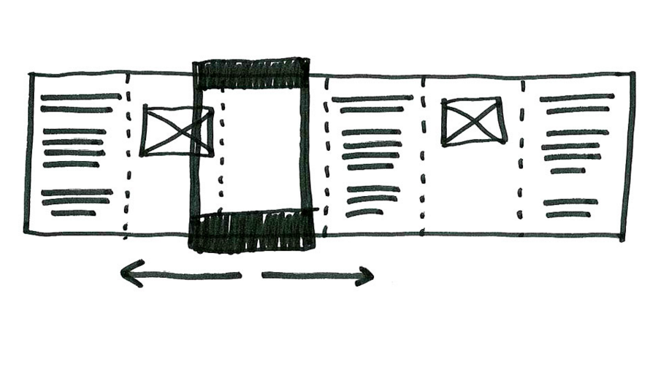
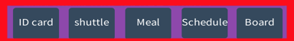
Use Case 8. Page Switch
Intuitive One Click
Access All Category Successfully

Slide 64
Analysis Model
4

Slide 65
Which?
Which diagrams are selected?
Use Case Diagram
Activity Diagram

Slide 66
Why?
Why are we select these diagrams?
Because…
HYUⓔmini is Activity-Oriented Application.

Slide 67
Use Case 1. Login/Logout
Sign up
In this application, we don't need it.
Find password
for students who forget their password
Change password
for student who did not change password for long time

Slide 68
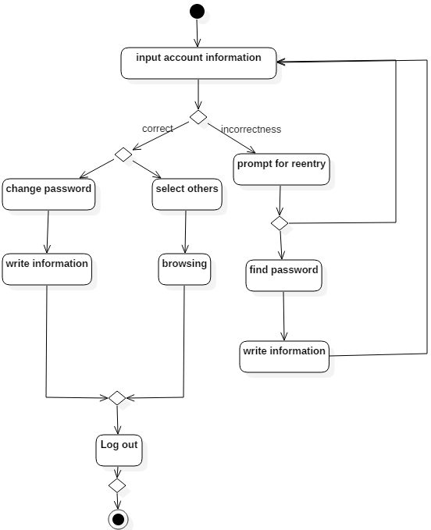
Use Case 1. Login/Logout
Activity Diagram
Log in
Log out
Find password
Change password

Slide 69
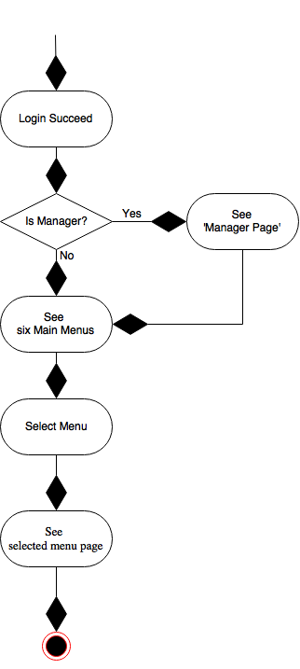
Use Case 2. Main Page

Slide 70
Use Case 3. BBS
Student’s Delete Process
Master’s Delete Process
*Process of deleting reply and deleting content are the same

Slide 71
Use Case 3. BBS
1
1
2
1
Student’s Editing Process
*Process of editing reply and editing content are the same

Slide 72
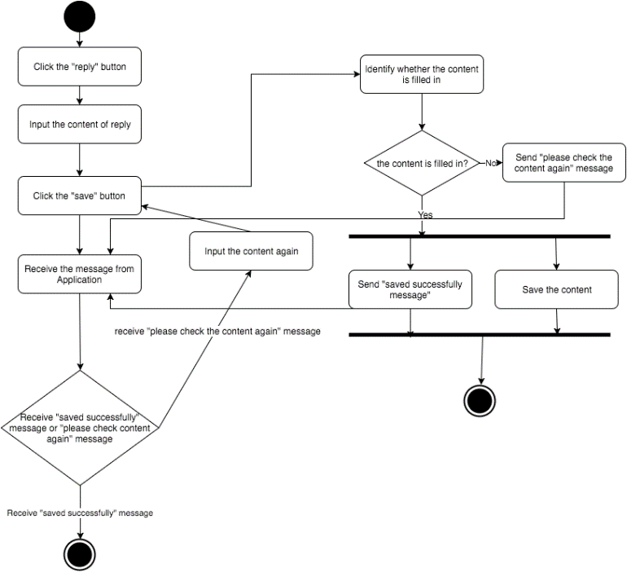
Use Case 3. BBS
Student’s Replying Process

Slide 73
Use Case 3. BBS
Student’s and Master’s Searching Process

Slide 74
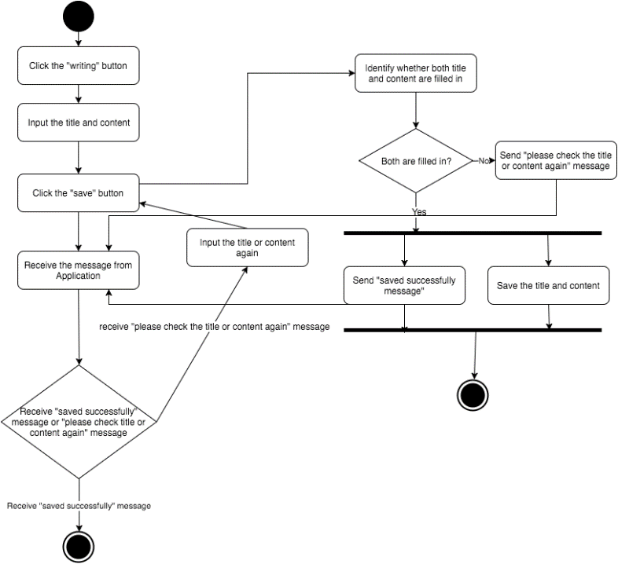
Use Case 3. BBS
Student’s and Master’s Reading Process
Student’s Writing Process

Slide 75
Use Case 4. Bus Schedule
Activity Diagram

Slide 76
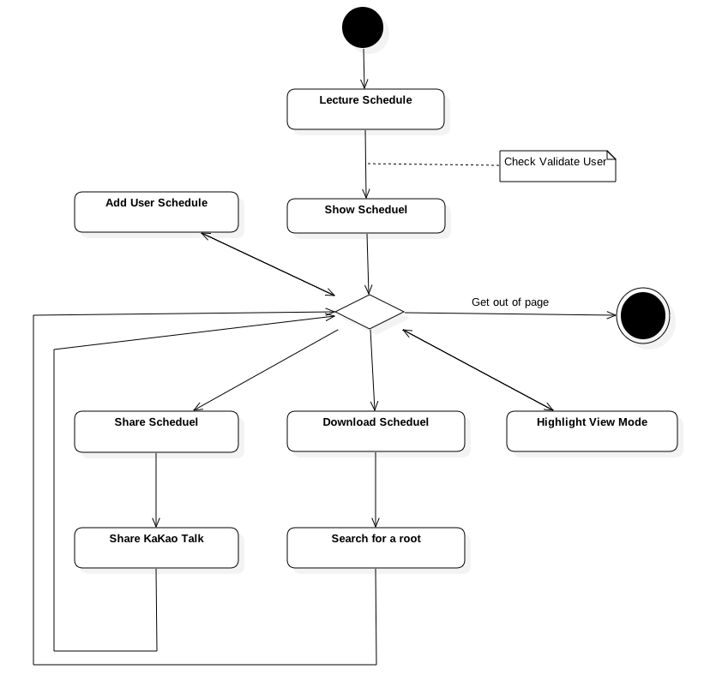
Use Case 5. Time Table
Activity Diagram
Show - Show the Lecture Schedule
Download - Download to storage
Share - Share Schedule to friends
Highlight - Highlight the near by schedule
Add - Add schedule not only lecture

Slide 77
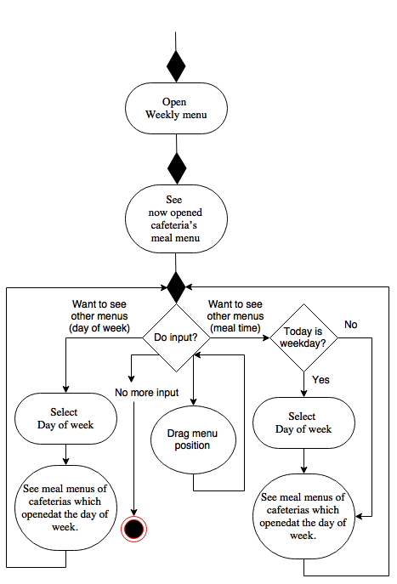
Use Case 6. Weekly Menu

Slide 78
Use Case7. Manager Page
Activity Diagram

Slide 79
Use Case 8. Page Switch
5 Button can be ‘Weekly Menu’, ‘Time Table’, ‘School Bus Schedule’, ‘Mobile Student ID’, ‘BBS’

Slide 80
Fin.

